Slide 1
Module 1
Introduction to Network Security & cryptography

Slide 2




What is Computer Security?
Computer security refers to protecting and securing computers and their related data, networks, software, hardware from unauthorized access, misuse, theft, information loss, and other security issues.
With growing internet, invaders, hackers and thieves are trying to harm our computer’s security for monetary gains, recognition purposes, ransom demands, bullying etc.

Slide 3
What is computer Security?
The protection of the assets of a computer system
Hardware
Software
Data
Each of these assets have different values to different members

Slide 4
What is Network Security?
Network Security refers to the measures taken by any enterprise or organization to secure its computer network and data using both hardware and software systems. This aims at securing the confidentiality and accessibility of the data and network.
The network security solutions protect various vulnerabilities of
the computer systems such as:
Users
Locations
Data
Devices
Applications

Slide 5
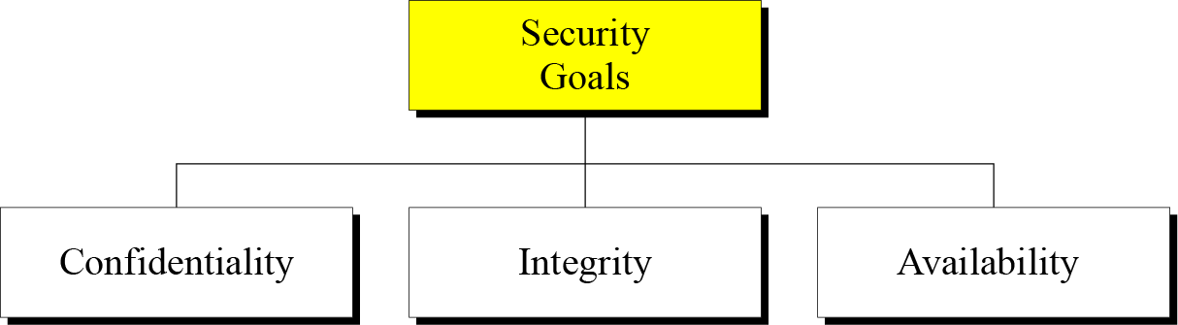
Security Goals

Slide 6

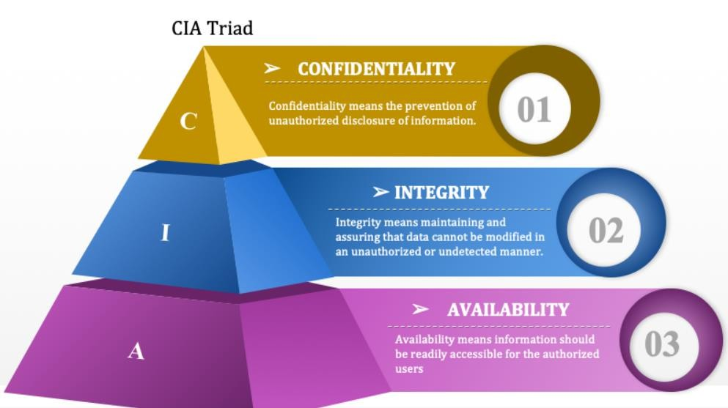
Confidentiality, Integrity, and Availability (CIA)
-basis for the development of security systems
Confidentiality: Integrity: Availability:
Unauthorized Access Unauthorized Change
Available to authorized entity whenever needed

Slide 7
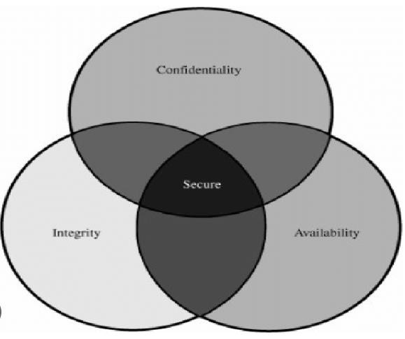
Confidentiality, Integrity, and Availability (CIA)
-basis for the development of security systems
Relationship between Confidentiality, Integrity and Availability

Slide 8
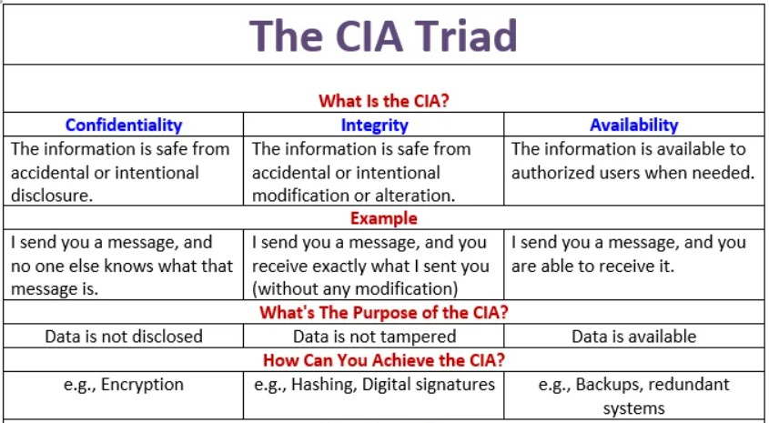
Confidentiality, Integrity, and Availability (CIA)
-basis for the development of security systems

Slide 9
Vulnerabilities, Threats, Attacks, Controls
Vulnerability is a weakness in the security system
(i.e., in procedures, design, or implementation), that might
be exploited to cause loss or harm.
Threat to a computing system is a set of circumstances that
has the potential to cause loss or harm.
a potential violation of security
Attack is an action that exploits a vulnerability or enacts a
threat.
Examples of attacks include sending malicious input to an application or flooding a network in an attempt to deny service.

Slide 10
Vulnerabilities, Threats, Attacks, Controls (Contd..)
How do we address these problems?
A control is an action, device, procedure, or technique that removes or reduces a vulnerability.
Threat is blocked by control of vulnerability
What is the differences between attack and Threat?
The main difference between threat and attack is:
-a threat can be either intentional or unintentional whereas
-an attack is intentional.

Slide 11

Types of Threats
Interception
Interruption
Modification
Fabrication

Slide 12
Types of Threats
An interception means that some unauthorized party has gained access to an asset
an interruption, an asset of the system becomes lost, unavailable, or unusable.
If an unauthorized party not only accesses but
tampers with an asset, the threat is a modification.
Finally, an unauthorized party might create
a fabrication of counterfeit objects on a computing system

Slide 13
























ATTACKS
The three goals of security⎯confidentiality, integrity, and availability⎯can be threatened by security attacks.
Types of Attacks
Passive Attacks
Active Attacks

Slide 14

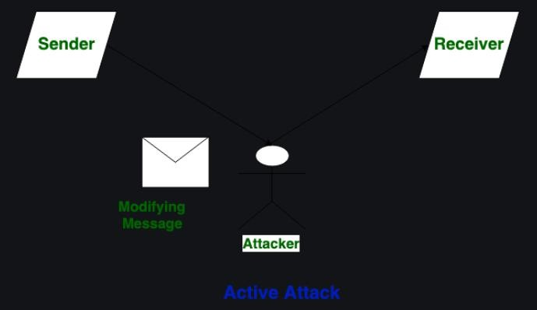
ACTIVE ATTACKS
Active attacks are the type of attacks in which, The attacker efforts to change or modify the content of messages. Active Attack is dangerous to Integrity as well as availability. Due to active attack system is always damaged and System resources can be changed. The most important thing is that, In an active attack, Victim gets informed about the attack.

Slide 15

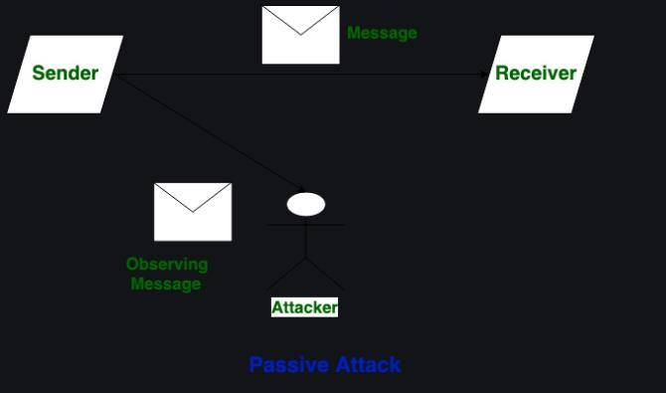
PASSIVE ATTACKS
Passive Attacks are the type of attacks in which, The attacker observes the content of messages or copies the content of messages. Passive Attack is a danger to Confidentiality. Due to passive attack, there is no harm to the system. The most important thing is that, In a passive attack, Victim does not get informed about the attack

Slide 16
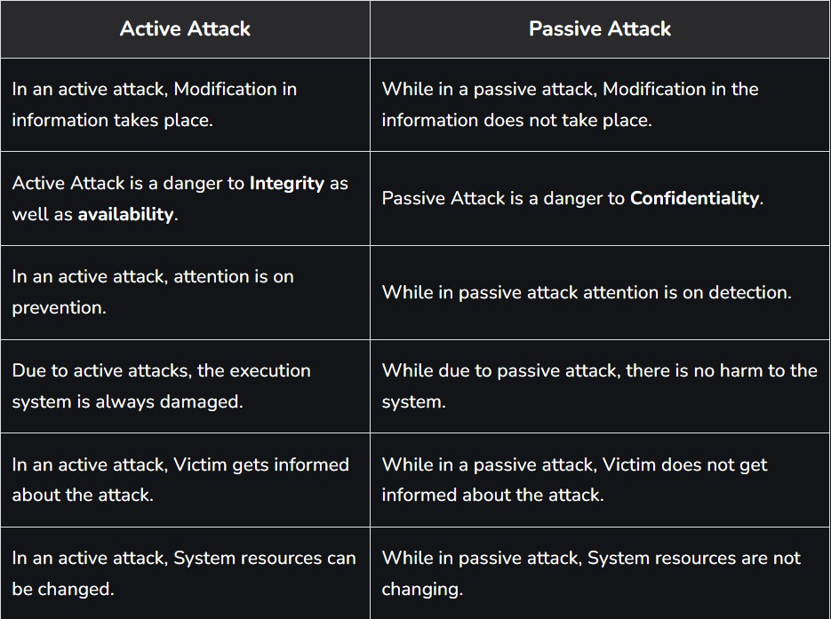
Difference between Active Attack and Passive Attack

Slide 17
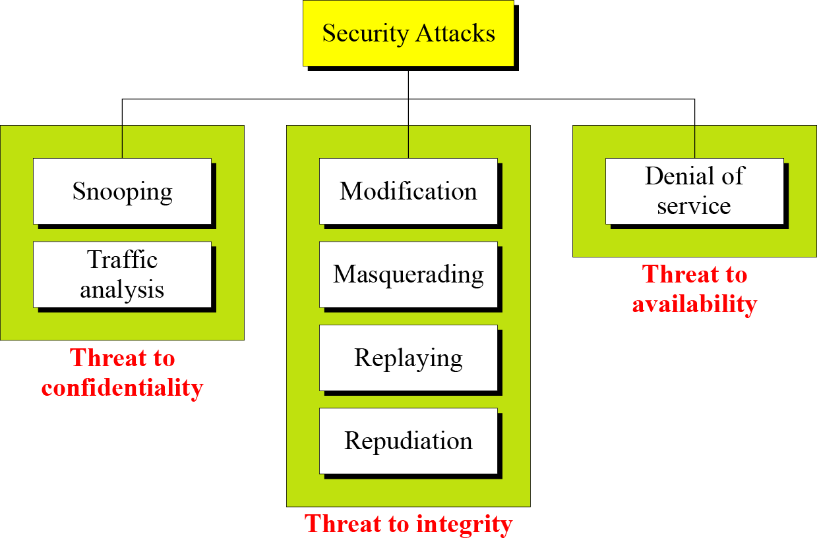
Taxonomy of attacks with relation to security goals

Slide 18
Attacks Threatening Confidentiality
Snooping occurs when a hacker intercepts, deletes, or modifies data that is transmitted between two devices also known as Eavesdropping or sniffing
Traffic analysis refers to obtaining some other type of information by monitoring online traffic.

Slide 19

































SERVICES AND MECHANISMS
ITU-T provides some security services and some mechanisms to implement those services. Security services and mechanisms are closely related because a mechanism or combination of mechanisms are used to provide a service..
Topics discussed in this section:
Security Services Security Mechanism
Relation between Services and Mechanisms

Slide 20
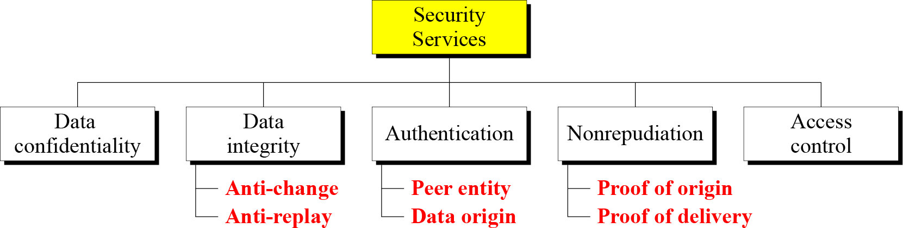
Security Services
NB- Peer Entity: for connection oriented Comm., Provides Authentication of Sender or Receiver during Connection establishment
For connectionless Communication: Authenticate source of data.
Access Control: Provides Protection against unauthorized access of data.

Slide 21
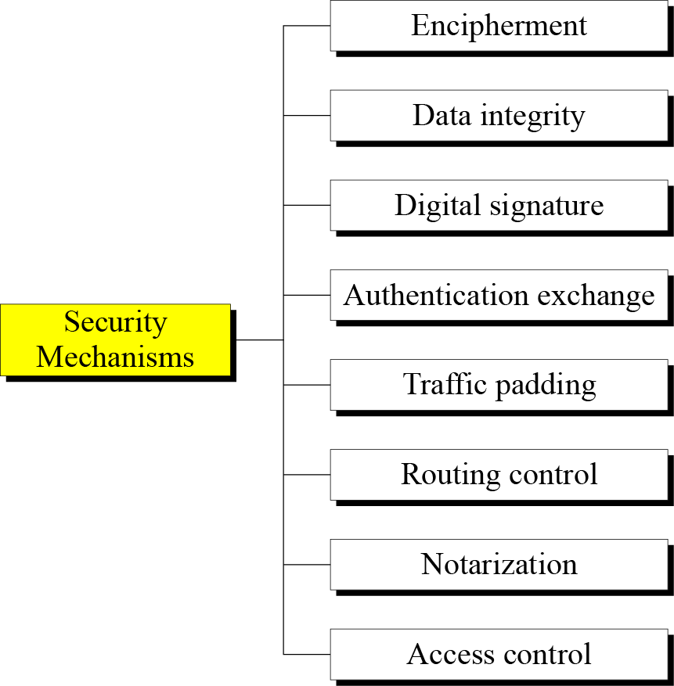
Security Mechanism

Slide 22
Security Mechanism
Encipherment: Hiding or Covering data ,Can provide confidentiality(Two Technique i.e. cryptography & steganography)
Data Integrity: Receiver receives data and check value from sender, create new check value from data of sender, compare both check values, if same integrity is preserved.
Digital Signature: Sender can electronically sign data & receiver can verify electronically.
Authentication Exchange:Two entities exchange some messages to prove their
identity to each other.
Traffic Padding: inserting some bogus data into the data traffic.
Routing Control: Selecting and continuously changing different available routs
between sender & receiver to pretect eavesdropping on a particular route.
Notarization: Selecting a trusted third party to control the communication between two entities.
Access Control: prove that a user has access right to the data or resource

Slide 23
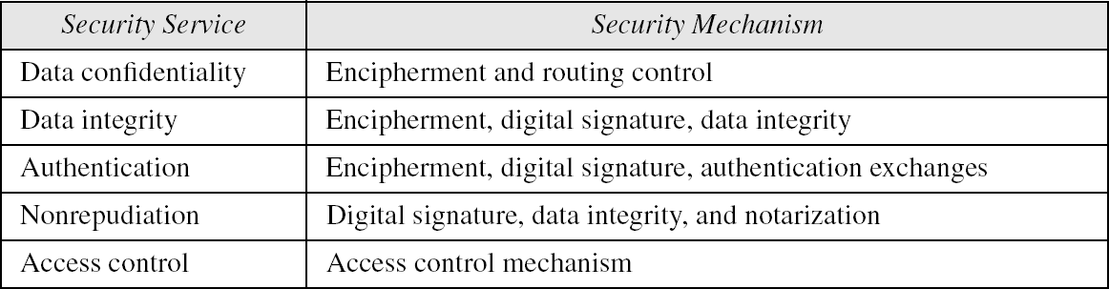
Relation between Services and Mechanisms

Slide 24
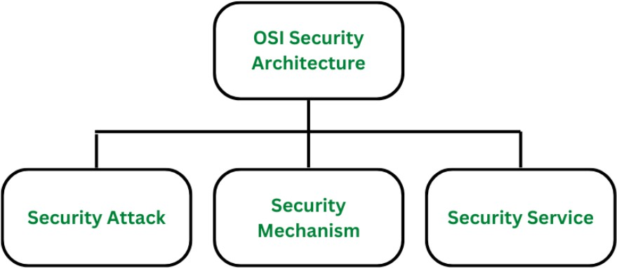
OSI Security Architecture

Slide 25
OSI Security Architecture
1. Security Attacks:
A security attack is an attempt by a person or entity to gain unauthorized access to disrupt or compromise the security of a system, network, or device. These are defined as the actions that put at risk an organization’s safety
2. Security Mechanism
The mechanism that is built to identify any breach of security or attack on the organization, is called a security mechanism. Security Mechanisms are also responsible for protecting a system, network, or device against unauthorized access, tampering, or other security threats. Some examples of security mechanisms include:
Encipherment (Encryption)
Digital signature
Traffic padding.
Routing control
3. Security Services:
Security services refer to the different services available for maintaining the security and safety of an organization, Security services are divided into 5 types:
Authentication
Access control.
Data Confidentiality
Data integrity
Non- repudiation

Slide 26
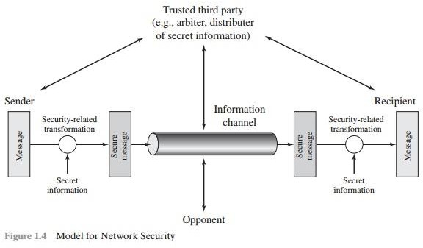
Network Security Model

Slide 27
Four basic tasks in designing a particular security service:
Design an algorithm for performing the security-related transformation. The algorithm should be such that an opponent cannot defeat its purpose.
Generate the secret information to be used with the algorithm.
Develop methods for the distribution and sharing of the secret
information.
Specify a protocol to be used by the two principals that makes use of the security algorithm and the secret information to achieve a particular security service.

Slide 28
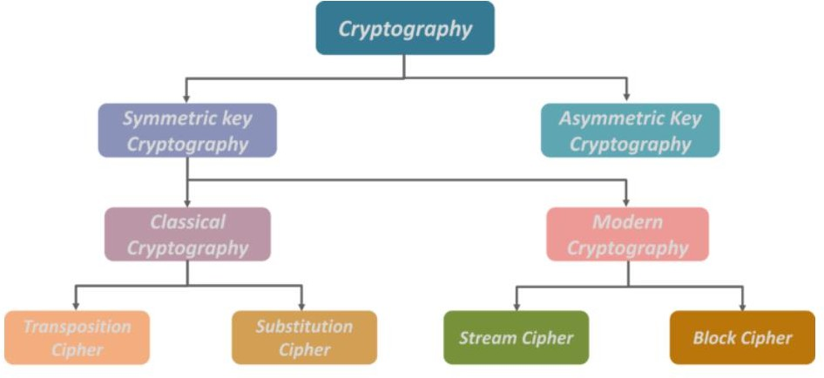
Classical Encryption techniques

Slide 29
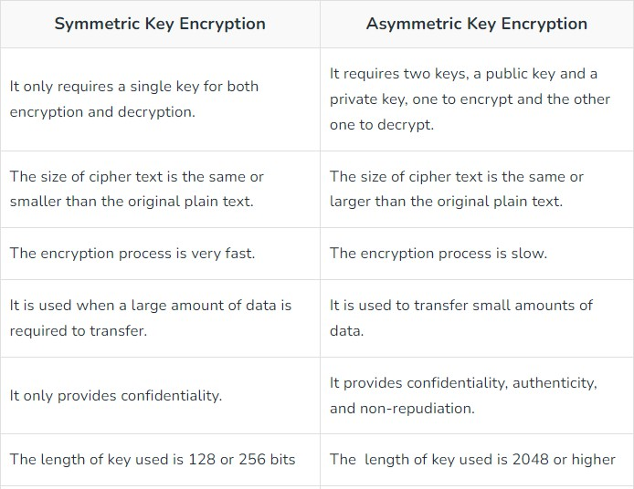
Difference Between Symmetric and Asymmetric Key Encryption

Slide 30
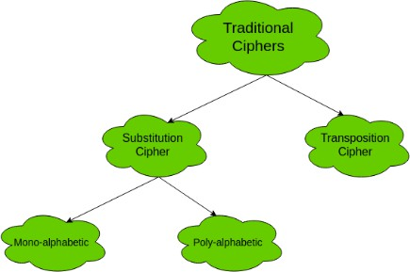
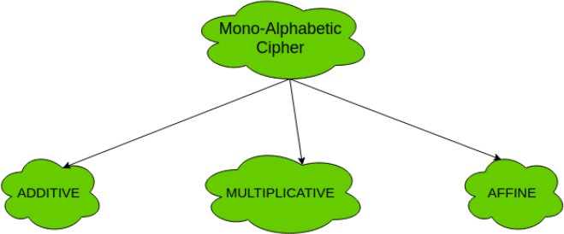
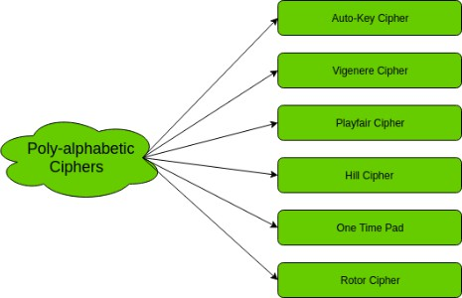

Slide 31
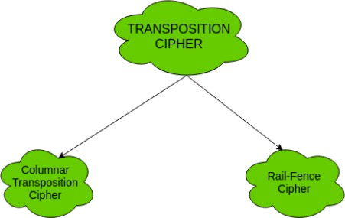
Transposition cipher

Slide 32
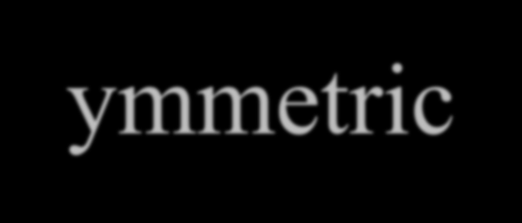



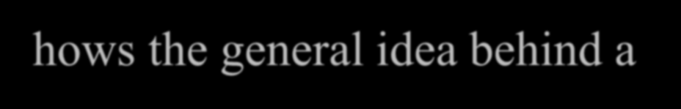

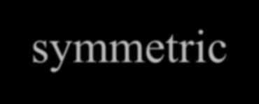





Symmetric-key cipher
Figure on next page shows the general idea behind a symmetric-key cipher.
The original message from Alice to Bob is called plaintext; the message that is sent through the channel is called the ciphertext.
To create the ciphertext from the plaintext, Alice uses an encryption algorithm and a shared secret key. To create the plaintext from ciphertext, Bob uses a decryption algorithm and the same secret key

Slide 33
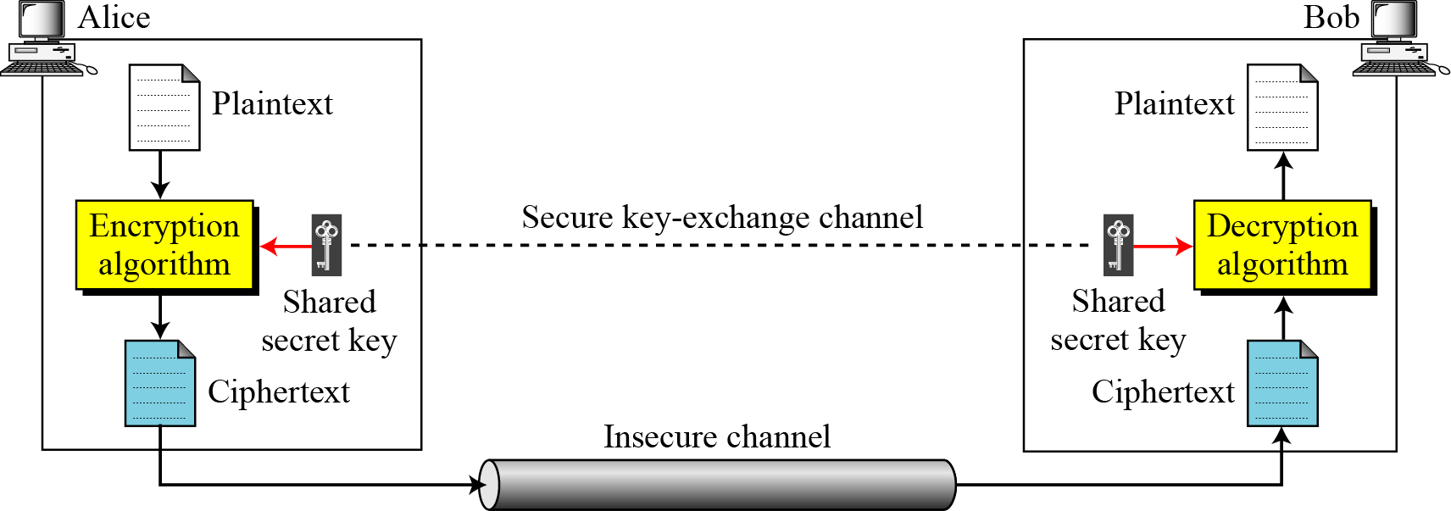
General idea of symmetric-key cipher

Slide 34











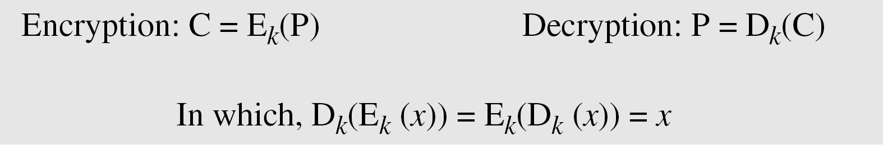













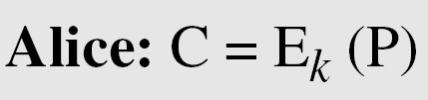
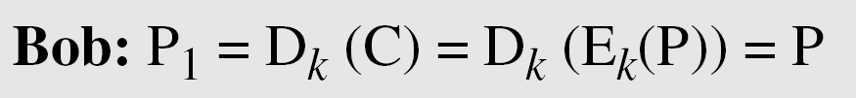
Continued
If P is the plaintext, C is the ciphertext, and K is the key,
We assume that Bob creates P₁; we prove that P₁ = P:

Slide 35
Kerckhoff’s Principle
Based on Kerckhoff’s principle, one should always assume that the adversary, Eve, knows the encryption/decryption algorithm. The resistance of the cipher to attack must be based only on the secrecy of the key.

Slide 36

























SUBSTITUTION CIPHERS
A substitution cipher replaces one symbol with another. Substitution ciphers can be
categorized as either monoalphabetic
ciphers or polyalphabetic ciphers.
Note
A substitution cipher replaces one symbol with another.
Topics discussed in this section:
Monoalphabetic Ciphres
Polyalphabetic Ciphers

Slide 37
Monoalphabetic Ciphers
Note
In monoalphabetic substitution, the relationship between a symbol in the plaintext to a symbol in the ciphertext is always one-to-one.

Slide 38
Continued
Example
The following shows a plaintext and its corresponding ciphertext. The cipher is probably monoalphabetic because both l’s (els) are encrypted as O’s.
Example
The following shows a plaintext and its corresponding ciphertext. The cipher is not monoalphabetic because each l (el) is encrypted by a different character.
Plaintext: hello Ciphertext: JCMWMK

Slide 39
Additive Cipher
The simplest monoalphabetic cipher is the additive cipher. This cipher is sometimes called a shift cipher, but the term additive cypher better reveals its mathematical nature. Historically, additive ciphers are called shift ciphers.The shift value is the key for encryption and decryption. Julius Caesar used an additive cipher to communicate with his officers. For this reason, additive ciphers are sometimes called the Caesar cipher(shift=3). Caesar used a key of 3 for his communications.
C=(P+k)Mod26
P=(C-k)Mod26

Slide 40
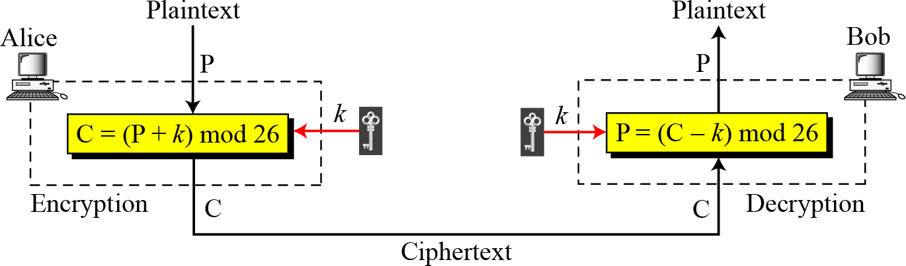
Additive cipher

Slide 41

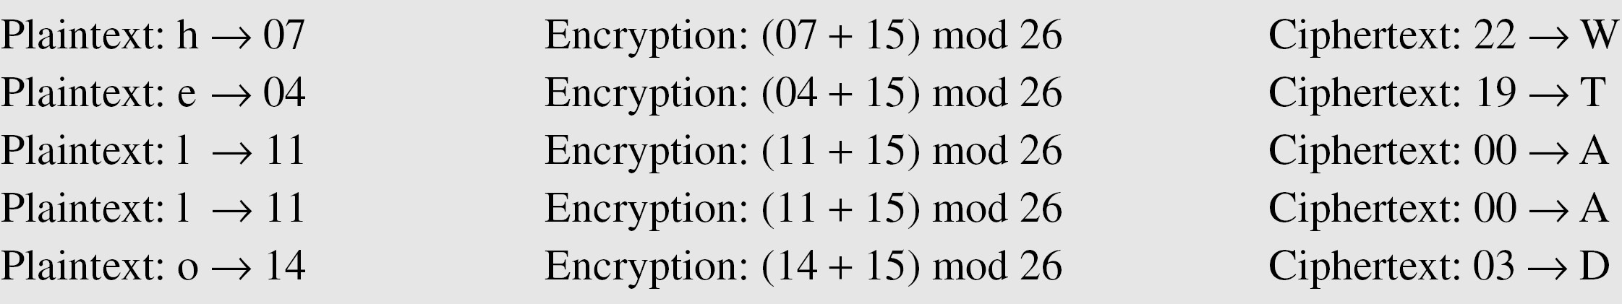
Example
Use the additive cipher with key = 15 to encrypt the message “hello”.
Solution
We apply the encryption algorithm to the plaintext, character by character:

Slide 42
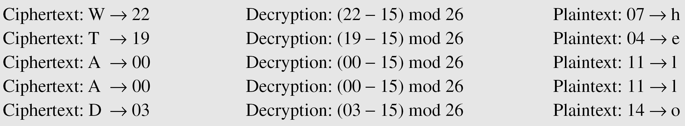
Example
Use the additive cipher with key = 15 to decrypt the message “WTAAD”.
Solution
We apply
the decryption algorithm to the plaintext character by
character:

Slide 43
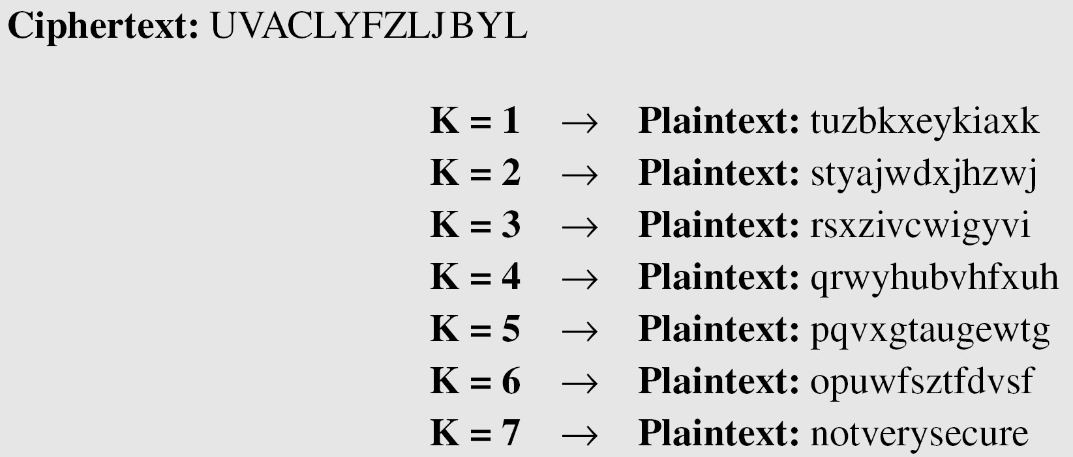
Example
Eve has intercepted the ciphertext “UVACLYFZLJBYL”. Show how she can use a brute-force attack to break the cipher.
Solution
Eve tries keys from 1 to 7. With a key of 7, the plaintext is “not very secure”, which makes sense.

Slide 44
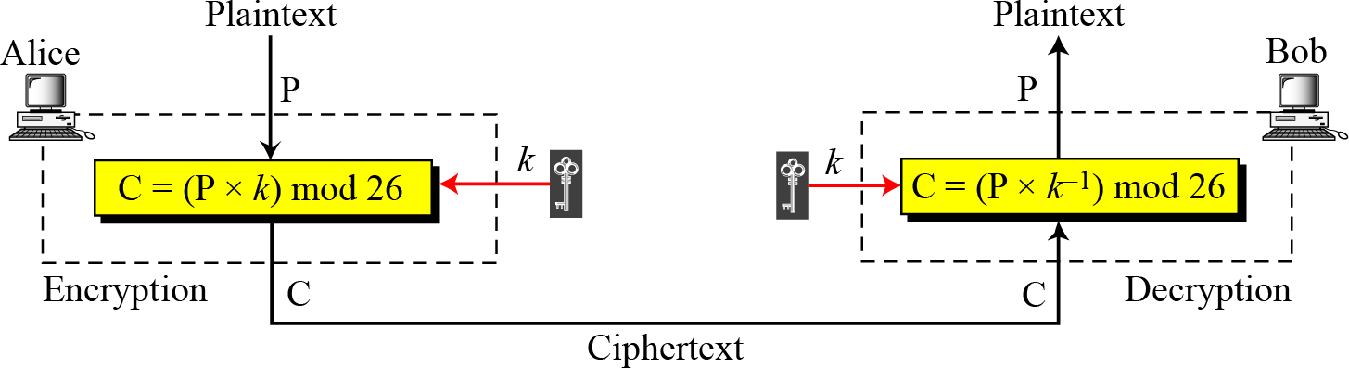
Continued
Multiplicative Ciphers

Slide 45
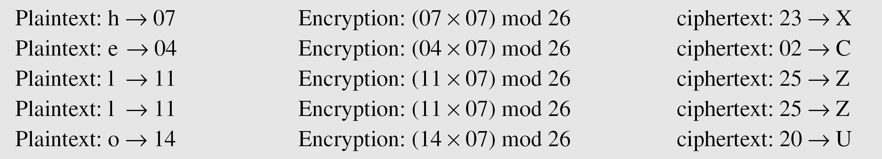
What is the key domain for any multiplicative cipher?
Example
Solution
The key needs to be in Z₂₆*. This set has only 12 members: 1, 3, 5, 7, 9,
11, 15, 17, 19, 21, 23, 25.
Example
We use a multiplicative cipher to encrypt the message “hello” with a key of 7.
The ciphertext is “XCZZU”.

Slide 46
Continued
Monoalphabetic Substitution Cipher
Because additive, multiplicative, and affine ciphers have small key domains, they are very vulnerable to brute-force attack.
A better solution is to create a mapping between each
plaintext character and the corresponding ciphertext character. Alice and Bob can agree on a table showing the mapping for each character.
Figure : An example key for monoalphabetic substitution cipher

Slide 47
Continued
Example
We can use the key below to encrypt the message
The ciphertext is

Slide 48

Example
Eve has intercepted the following ciphertext. Using a statistical attack, find the plaintext.
Solution
When Eve tabulates the frequency of letters in this ciphertext, she gets: I =14, V =13, S =12, and so on. The most common character is I with 14 occurrences i.e. probable “e”

Slide 49
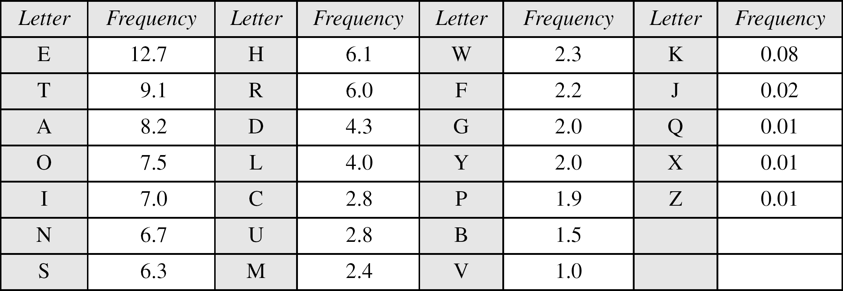
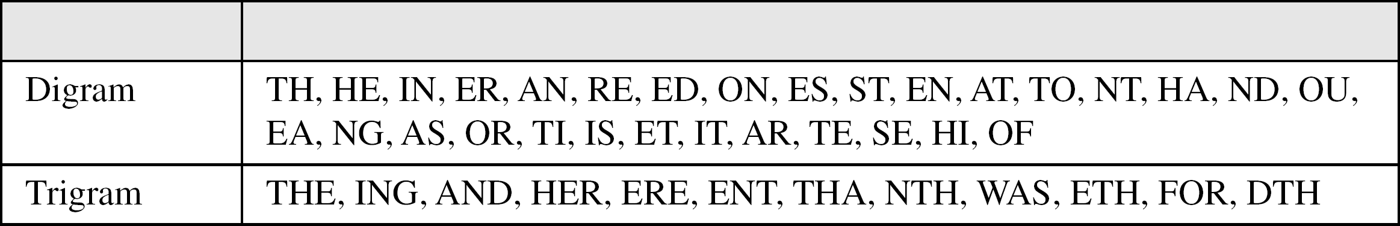
Continued
Table: Frequency of characters in English
Table : Frequency of diagrams and trigrams

Slide 50
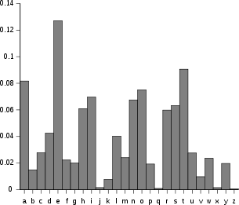
Frequency analysis of English alphabets

Slide 51
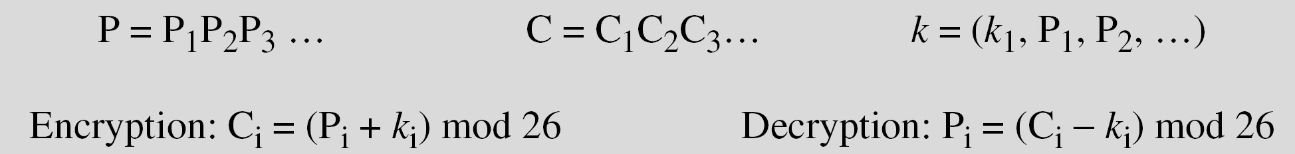
Polyalphabetic Ciphers
In polyalphabetic substitution, each occurrence of a character may have a different substitute. The relationship between a character in the plaintext and a character in the ciphertext is one-to-many.
Autokey Cipher

Slide 52
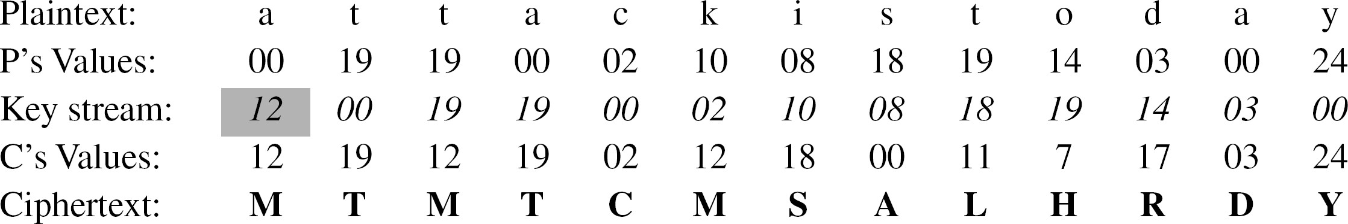
Continued
Example
Assume that Alice and Bob agreed to use an autokey cipher with initial key value k1 = 12. Now Alice wants to send Bob the message “Attack is today”. Enciphering is done character by character.

Slide 53
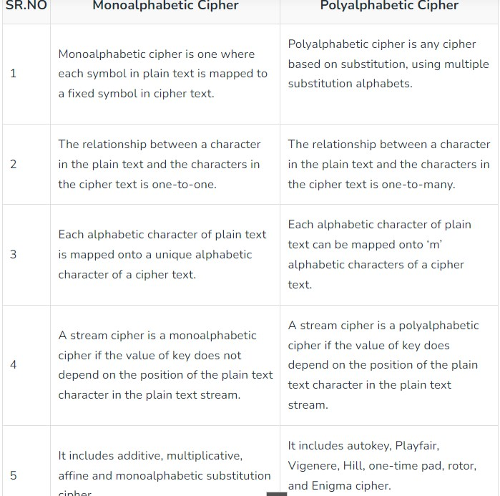

Slide 54
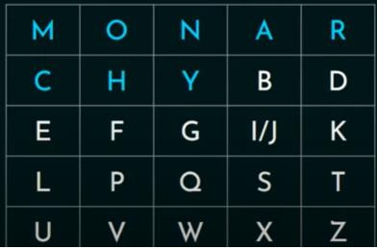
Playfair cipher
Multiple letter encryption cipher
Diagram
5x5 matrix constructed using a random keyword(ex. Monarchy)
Secrete Key=

Slide 55
Rules for encryption using Playfair cipher
Create Digrams(of two letters) of plain text
If repeating Letter in the same diagram-(Add filler ‘x’ between them)
If letters in Digrams are in the Same Column “Encode with below character in the matrix”, if the last character is in the column, then wrap-around
If letters in Digrams are in the Same row “Encode with the character ahead ”, if it is the last character in the row, then wrap around
If letters in Diagrams are in Different rows and different columns, then they form a rectangle with characters in digrams at the corners diagonally. Encode these characters with the characters in the opposite corner of that row
Odd number of characters in the Plain text- (Add filler ‘x’ at the end)

Slide 56
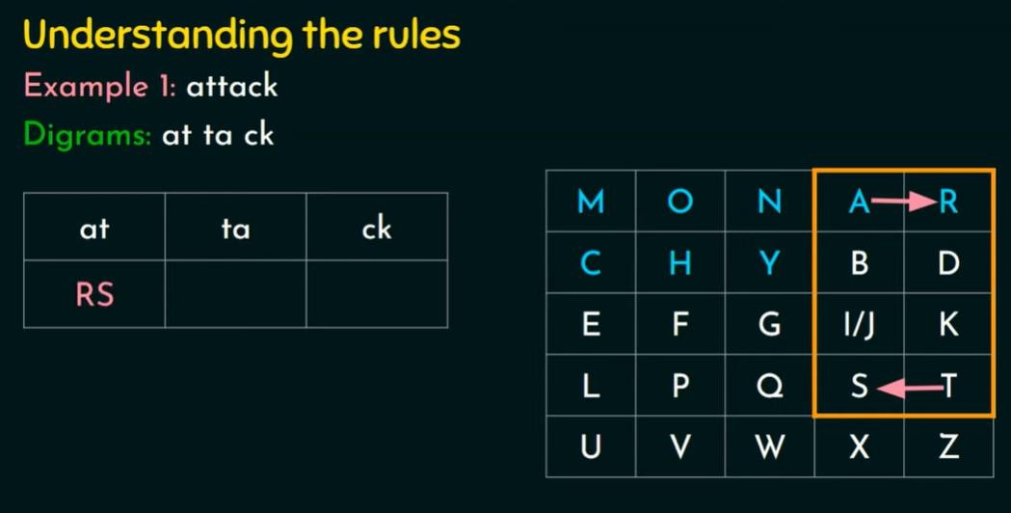
Example of playfair: attack

Slide 57
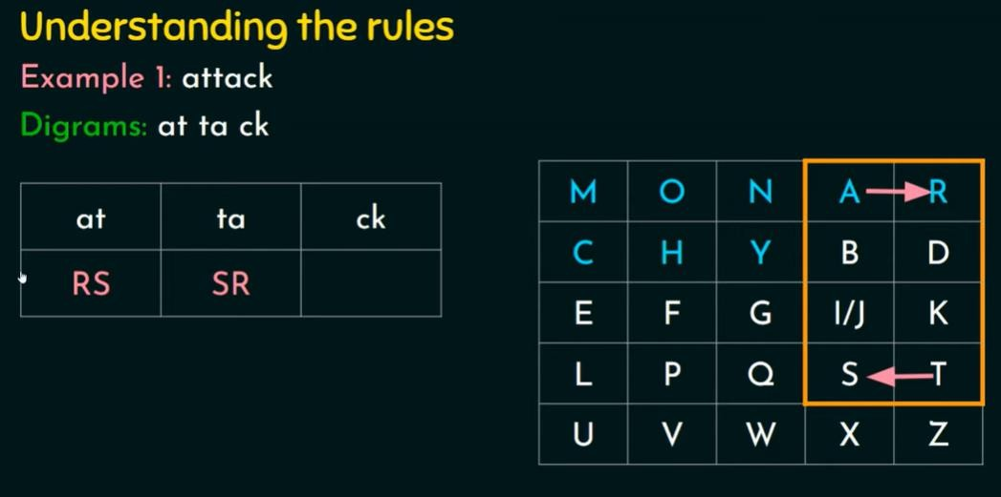

Slide 58
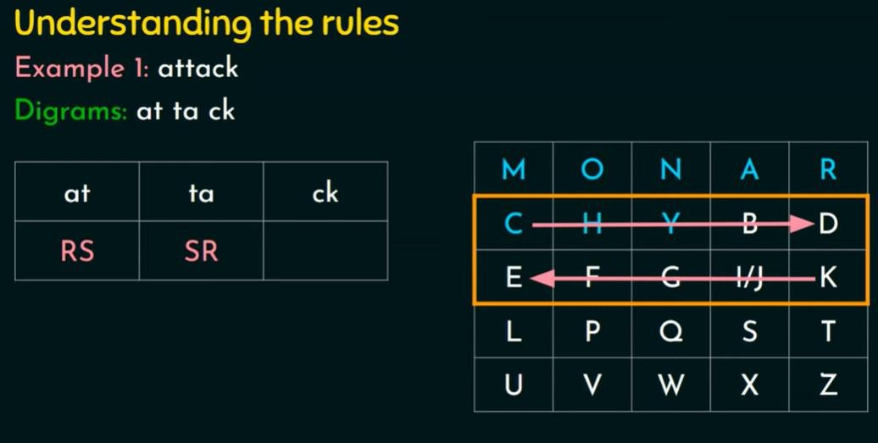

Slide 59
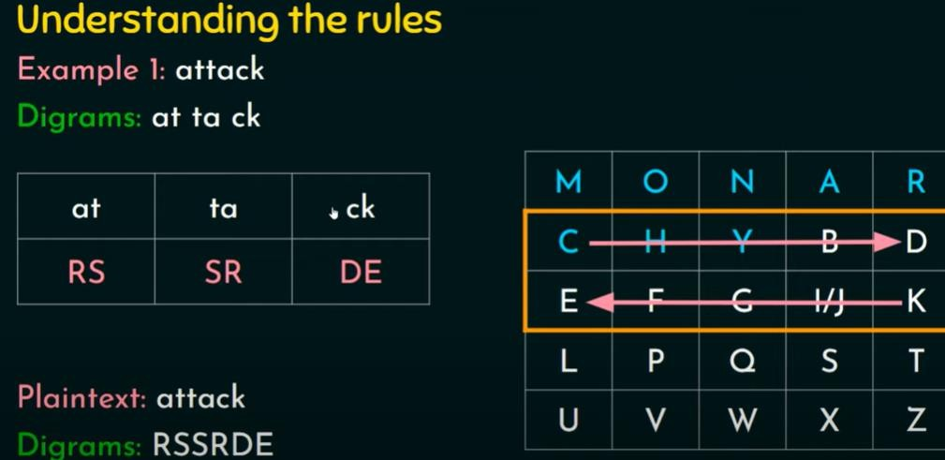

Slide 60
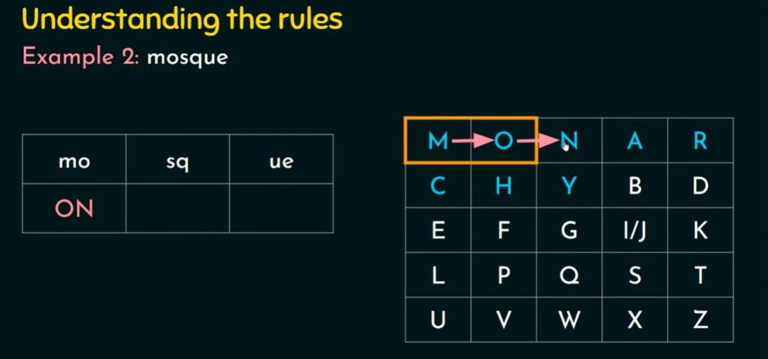
Example 2 of playfair: masque

Slide 61
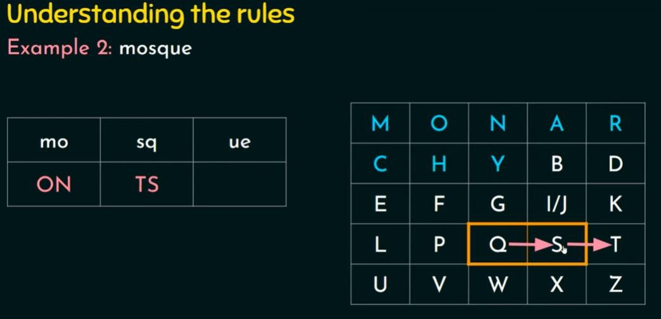

Slide 62
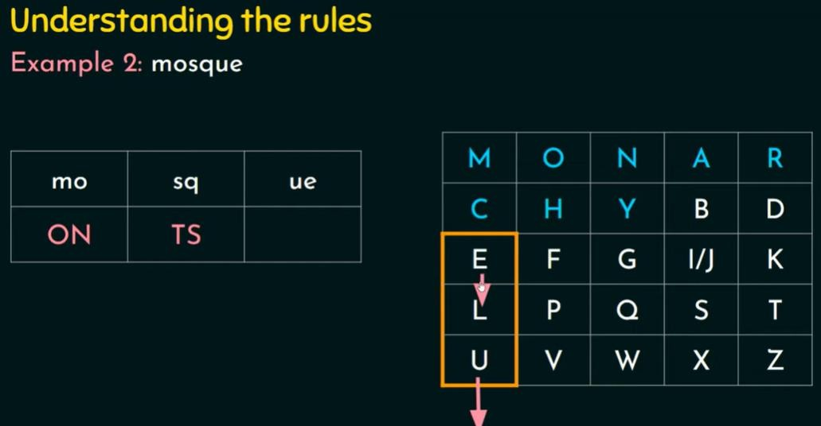

Slide 63
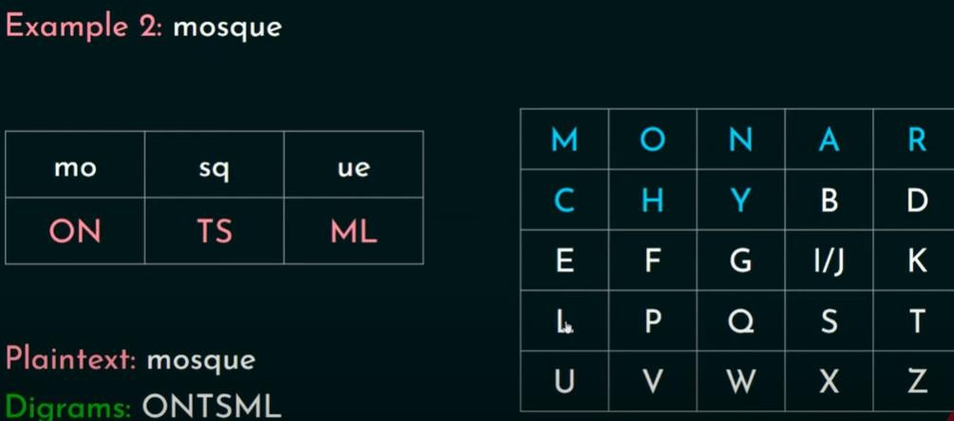

Slide 64
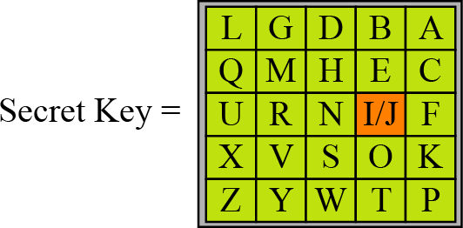
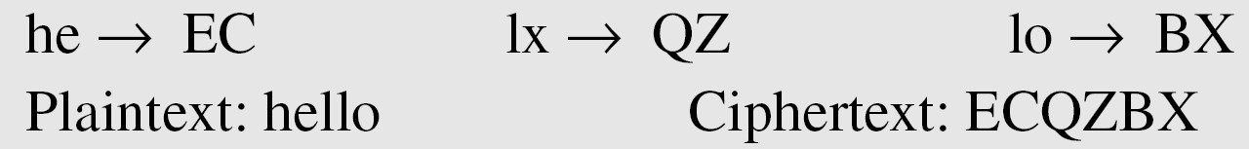
Playfair Cipher
An example of a secret key in the Playfair cipher
Example
Let us encrypt the plaintext “hello” using the key in above figure, here there are 2 l, so we need filler character i.e. ‘x’

Slide 65
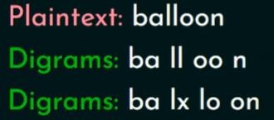
Example: Calculate Cipher text
Secrete key=

Slide 66


Slide 67


Slide 68

A=0,b=1,c=2,d=4,e=4,f=5,g=6,h=7,i=8……..z=25

Slide 69


Slide 70

Add both the number

Slide 71


Slide 72

15+17=32so 32 mod 26= 6
6-15=9 so Plaintext is 26-9=17
21+18=39 so 39 mod 26= 13
13-21=8 so Plaintext is 26-8=18

Slide 73
Keyless Transposition Cipher
(Position are going to change, not alphabets are going to change like substitution)
A transposition cipher does not substitute one symbol for another
instead it changes the location of the symbols.
Keyless Transposition Cipher:
In this cipher technique, the message is converted to ciphertext by either of two permutation techniques:
Text is written into a table row-by-row and is then transmitted column-by-column.
Text is written into a table column-by-column and is then
transmitted row-by-row.

Slide 74

Size of rectangle decided by sender as well as receiver

Slide 75


Slide 76

Random letter
Random Key

Slide 77



Slide 78

What is Steganography?

Slide 79



Slide 80


Types of Steganography

Slide 81


Slide 82

Application of Steganography

Slide 83

Steganography Vs. Cryptography

